Slide 1
HPOG RoundTable Pre-Work – Running PAGES Reports
January 10th, 2018

Slide 2
We want you to help you develop skills with interpreting and manipulating PAGES data. This involves:
Running PAGES reports to get your program’s HPOG data
Extracting that data to Excel and refining it
Visually tailoring that information to your desired audiences in support of your Communications Plan.
NOTE: you will be provided with an instructional document and the slides from this webinar to help you prepare for the RoundTable.
Notes:
- Make clear that

Slide 3
During this session we will be:
Demonstrating how to access Advanced Find in PAGES, find pre-constructed reports, and run them.
Demonstrating how to extract those reports to Excel.
Explaining what you should do to prepare your reports for the HPOG RoundTable.
NOTE: you need to bring your saved PAGES reports to the HPOG RoundTable.

Slide 4
We are not covering all of PAGES reporting – for a reporting refresher, please use these resources:
The PAGES User Manual. From the PAGES Welcome Page, find “Document Resources” and click on the entry titled “a PAGES User Guide.”
The PAGES Reporting Webinars. Also in “Document Resources” on the Welcome Page, find “Reporting in PAGES Training Slides.” Or click here for a link to a recording of the webinar:
https://attendee.gotowebinar.com/recording/2015708665061126918

Slide 5
Pre RoundTable Activities:
Access the three Advanced Find reports that have been shared with you.
Run each report and export each to Excel.
Open the Excel file and “Save As” to either the computer you are bringing to the RoundTable, or to a USB Flash Drive you can bring (NOTE: please ensure your computer at the RoundTable has Excel installed).
Bring the three reports to the RoundTable and be prepared to work with them during the session – if possible, think beforehand about what you could do with the data to support your Communications Plan.

Slide 6
1. Accessing the Advanced Find Reports
From anywhere in PAGES, click on the following link at the top of the screen to access the Advanced Find window:
Close-up:

Slide 7
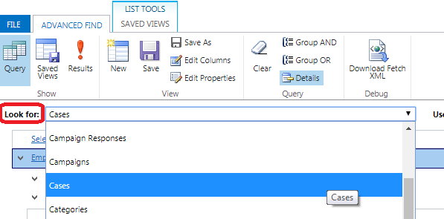
1. Accessing Advanced Find, Cont’d
A pop-up will appear with Advanced Find. To find each report, you will need to change the “Look for” field to the correct category.
Change “Look for” by clicking the dropdown and selecting the appropriate category:

Slide 8
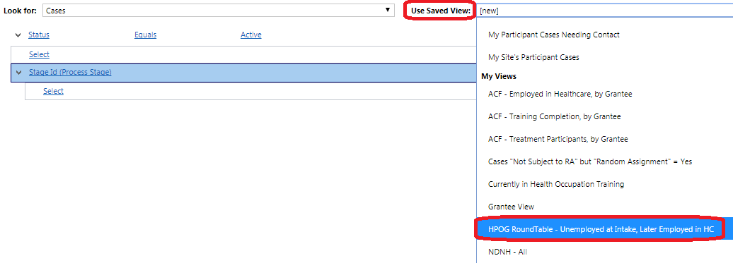
1. Accessing Advanced Find, Cont’d
Once you have selected the Look For category, you can find the saved view to the right under “Use Saved View.” Click on the dropdown and then scroll down to “My Views” where you will find the RoundTable view labelled as such:

Slide 9
1. Accessing Advanced Find, Cont’d
The three reports can be found by setting “Look for” as follows, and checking for these titles:
Report Number | “Look For” Category | Report Title under “Use Saved View”
1 | Cases | HPOG RoundTable – Unemployed at Intake, Later Employed in HC
2 | Employment History | HPOG RoundTable – Employments in Healthcare
3 | Service Details | HPOG RoundTable – Health Occupation Training Data

Slide 10
2. Run each report and export to Excel.
Once you have selected a report under “Use Saved View,” the report logic will display. Click on “Results” to run the report:

Slide 11
2. Run each report and export to Excel.
When results pop up, click on the “Export” tool on the right side of the Tool Bar. It will have the category listed (i.e. Export Cases, Export Employment History, Export Service Details, depending on the report you are running). Select “Static Worksheet” from the dropdown:

Slide 12
3. Open in Excel and “Save As”
After clicking “Static Worksheet,” the system will generate an Excel file for download from your browser. This will take approximately 5 to 20 seconds. It will show up on your browser’s download menu (usually at the bottom or top of the screen). Click “Open”:

Slide 13
3. Open in Excel and “Save As”
An Excel file will open with the report you just ran. Click on “Save As” and give the file a new name that you will recognize. Please ensure that you save these files to the laptop you will be bringing, or to a USB storage device that you will have access to. You will be working with these files at the RoundTable.

Slide 14
Report 1 – Participant Progression
Participant Progression: This is a report to show cumulative participant employment progress. The query is of participants not employed at intake who later gained healthcare employment.
Columns include:
Grantee site
Intake TANF status
Number of HC training began / completed
Number of employments and number of HC employments.
Challenge assignment (optional): add another condition at intake, such as restricting by TANF status (either Yes or No), or any other intake condition desired.

Slide 15
Report 2 – Employment Report
Employment Report: This report generates an extract of participant employments in healthcare, with start dates, since the start of HPOG.
Columns include:
Grantee site
Employer
Job Type (new or promotion)
Job Start / End Dates
Occupational Code
Hourly Wage
Hours worked per week
Challenge assignment (optional): generate a chart or shell that you could fill with this data.

Slide 16
Report 3 – Health Occupation Training Data
Health Occupation Training Data: Generate a report of all “Service Details” where the category equals “Health Occupation Training.”
Columns include:
Grantee site
Basic Skills Trainings Began/Completed (number)
Total Count of Supportive Services
Occupational Code
Vendor
Begin/End Dates
Projected Completion Date
Completion Status
Is Latest Healthcare Training
Is First Completed Healthcare Training
Challenge assignment (option): generate a chart or shell that you could fill with this data.

Slide 17
Personally Identifiable Information (PII)
By default, these reports do NOT include PII. If you choose to modify them in any way, please ensure that they do not contain any PII (participant names or contact information).

Slide 18
System Demonstration

Slide 19
Questions?

